Slide 1
Memory and storage system
MD. MILON ISLAM
MD. MASUM AL MASBA

Slide 2
Motivation
2
Data is stored on external storage devices and fetched into main memory as needed for processing
Page/Block is unit of information read from or written to disk.
2/18/2020

Slide 3
Classification of Physical Storage Media
3
Based on
speed with which data can be accessed
Cost per unit of data
Reliability
data loss on power failure or system crash
physical failure of the storage device
Can differentiate storage into:
volatile storage: loses contents when power is switched off
non-volatile storage:
Contents persist even when power is switched off.
Includes secondary and tertiary storage, as well as battery- backed up main-memory.
2/18/2020

Slide 4
Physical Storage Media
4
Cache – fastest and most costly form of storage; volatile; managed by the computer system hardware.
Main memory:
fast access
Generally small (or too expensive)
Volatile — contents of main memory are usually lost if a power failure or system crash occurs.
2/18/2020

Slide 5
Physical Storage Media (Cont.)
5
Flash memory
Data survives power failure
Data can be written at a location only once, but location can be erased and written to again
Reads are roughly as fast as main memory
But writes are slow (few microseconds), erase is slower
Cost per unit of storage roughly similar to main memory
Widely used in embedded devices such as digital cameras
Is a type of EEPROM (Electrically Erasable Programmable Read-Only Memory)
2/18/2020

Slide 6
Physical Storage Media (Cont.)
6
Magnetic-disk
Data is stored on spinning disk, and read/written magnetically
Primary medium for the long-term storage of data
Data must be moved from disk to main memory for access, and written back for storage
direct-access – possible to read data on disk in any order, unlike magnetic tape
Survives power failures and system crashes
disk failure can destroy data, but is rare
2/18/2020

Slide 7
Physical Storage Media (Cont.)
7
Optical storage
non-volatile, data is read optically from a spinning disk using a laser
CD-ROM (700 MB) and DVD (4.7 to 17 GB) most popular forms
Write-one, read-many (WORM) optical disks used for archival storage (CD-R, DVD-R, DVD+R)
Multiple write versions also available (CD-RW, DVD-RW, DVD+RW, and DVD-RAM)
Reads and writes are slower than with magnetic disk
2/18/2020

Slide 8
Physical Storage Media (Cont.)
8
Tape storage
non-volatile, used primarily for backup (to recover from disk failure), and for archival data
sequential-access – much slower than disk
very high capacity
tape can be removed from drive ⇒ storage costs much cheaper than disk, but drives are expensive
Tape jukeboxes available for storing massive amounts of data
hundreds of terabytes (1 terabyte = 10⁹ bytes) to even a petabyte (1 petabyte = 10¹² bytes)
2/18/2020

Slide 9
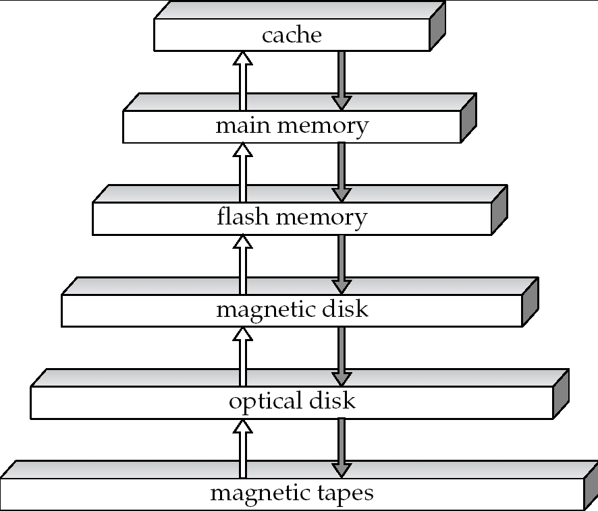
Storage Hierarchy
9
Cost
Cost
Speed
Speed
2/18/2020

Slide 10
Storage Hierarchy (Cont.)
10
primary storage: Fastest media but volatile (cache, main memory).
secondary storage: next level in hierarchy, non-volatile, moderately fast access time
also called on-line storage
E.g. flash memory, magnetic disks
Tertiary storage: lowest level in hierarchy, non-volatile, slow access time
also called off-line storage
E.g. magnetic tape, optical storage
2/18/2020

Slide 11
Storage Devices
Storage devices are categorized by:
The method they use to access the information
The technology they use
Their location in the storage hierarchy
Their capacity and speed
2/18/2020

Slide 12
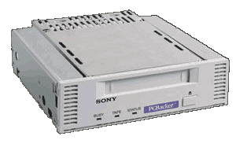
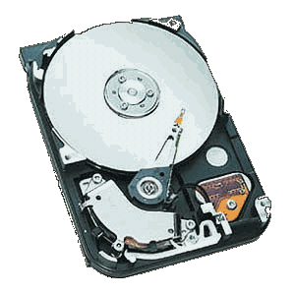
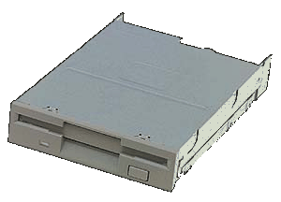
Sequential vs. Random Access Storage
Tape Drive – sequential storage
Floppy Disk Drive – random-access storage
Hard Disk – random-access storage
Sequential – Storage devices that read and write data in a serial (one after the other) fashion
Random-Access – Storage devices that read and write data without going through a sequence of locations
2/18/2020

Slide 13
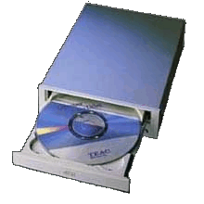
Storage Technologies: Magnetic and Optical
Magnetic Storage
Optical Storage – CD/DVD drive
Magnetic – Storage devices use disks or tapes that are coated with magnetically sensitive material
Optical – Storage devices that use laser beams to read patterns etched into plastic disks
2/18/2020

Slide 14
The Storage Hierarchy
The three levels of storage hierarchy are:
Online storage – Also called primary storage,
Near-online storage – Also called secondary storage,
Offline storage – Also called tertiary storage or archival storage. Devices such as tape backup units store data for archival purposes.
2/18/2020

Slide 15
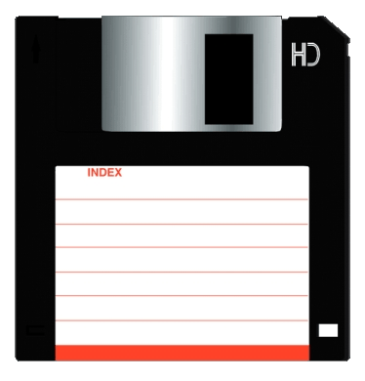

Storage Capacity and Speed
Floppy Disk
Hard Drive
CD ROM / DVD
Capacity – 1GB to 10GB
Access Time – 25ms
Capacity – Up to 1000 GB
Access Time – 9 to 15ms
Capacity – CD-ROM 700 MB; DVD 17 GB
Access Time – 80 to 800ms
A storage device’s performance is measured by:
Capacity – The number of bytes of data that a device can hold
Access Time – The amount of time, in milliseconds (ms), it takes the device to begin reading data
2/18/2020

Slide 17
CLASSIFICATION- BIG PICTURE
Registers
2ns
17
Cache (I, II, III)
Volatile
SRAM
Memory Types &
Storage Devices
DRAM
Primary
SDRAM
RAM
EDRAM
(Semiconductor – chip). Main Memory
EDO
FLASH RAM
PROM
Non-volatile
EPROM
ROM
EEPROM
Tape
Magnetic memory
HD, Zip Disk
Secondary
FDD
(Devices)
CD-ROM, CD-R, CD-RW
Optical Memory
DVD-ROM, DVD-R
5ms
DVD- RW
2/18/2020

Slide 19
Storage Capacity
19
Sr.No. | Unit | Description
1 | Kilobyte (KB) | 1 KB = 1024 Bytes
2 | Megabyte (MB) | 1 MB = 1024 KB
3 | GigaByte (GB) | 1 GB = 1024 MB
4 | TeraByte (TB | 1 TB = 1024 GB
5 | PetaByte (PB) | 1 PB = 1024 TB
2/18/2020

Slide 20
Storage Capacity
20
1024 | KB | kilobyte | 2¹⁰
1024² | MB | megabyte | 2²⁰
1024³ | GB | gigabyte | 2³⁰
1024⁴ | TB | Terabyte | 2⁴⁰
1024⁵ | PB | Petabyte | 2⁵⁰
1024⁶ | EB | Exabyte | 2⁶⁰
1024⁷ | ZB | Zettabyte | 2⁷⁰
1024⁸ | YB | Yottabyte | 2⁸⁰
2/18/2020

Slide 21
Storage Capacity
21
Is there anything bigger than a Yottabyte?
As of July 30, 2019, there are no approved standard sizes for anything bigger than a Yottabyte. However, the two standards that have been proposed are the Hellabyte or Brontobyte.
How many 4MB MP3 files can be stored in a 20 GB HDD?
20*(1,024 / 4) =20* 256 4MB MP3 files.
2/18/2020

Slide 22
Memory
22
9278
9279
9280
9281
9282
9283
9284
9285
9286
Main memory is divided into many memory locations (or cells)
Each memory cell has a numeric address, which uniquely identifies it
2/18/2020

Slide 23
Storing Information
23
Each memory cell stores a set number of bits (usually 8 bits, or one byte)
9278
9279
9280
9281
9282
9283
9284
9285
9286
10011010
Large values are
stored in consecutive
memory locations
2/18/2020

Slide 24
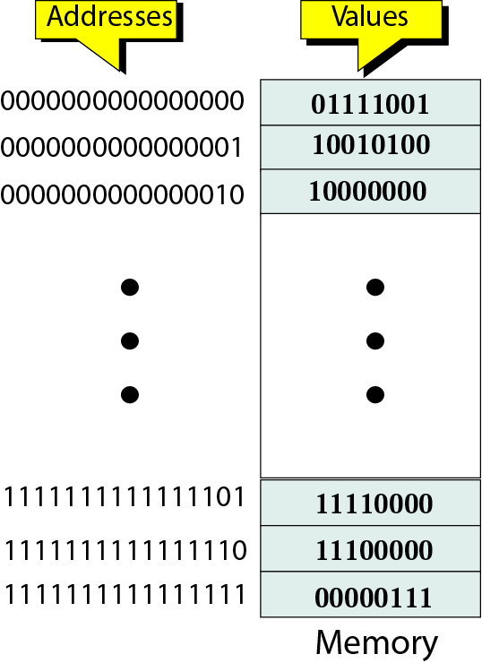
Storing Information
24
2/18/2020

Slide 25
Memory Types
25
RAM (Random Access Memory)
Volatile and R/W by user
Two categories:
DRAM(Dynamic RAM)
Need to refresh
Slow and short life time
Less power consumption, less size and less expensive
SRAM(Static RAM)
No refresh
Faster more reliable
more expensive
often used only as a memory cache
2/18/2020

Slide 26
Memory Types
26
ROM (Read Only Memory)
Nonvolatile
Written by manufacture
Hold the booting program
2/18/2020

Slide 27
Address Space
27
Word-
Data are transferred to and from memory in groups of bits called words.
The number of bits that can be stored in one CPU register in a computer.
Although programmers use a name to identify a word, at the hardware level, each word is identified by an address.
Address space -
The total number of uniquely identifiable locations in memory.
For example: a memory with 64KB and a word size of 1 byte has an address space that range from 0 to 65535.
2/18/2020

Slide 28
Address Space
28
Example 1
A computer has 32 MB of memory. How many bits are needed to address any single byte in memory?
Solution
The memory address space is 32 MB, or 2²⁵ (2⁵ x 2²⁰). This means you need log₂ 2²⁵ or 25 bits, to address each byte.
2/18/2020

Slide 29
Address Space
29
Example 2
A computer has 128 MB of memory. Each word in this computer is 8 bytes. How many bits are needed to address any single word in memory?
Solution
The memory address space is 128 MB, which means 2²⁷. However, each word is 8 (2³) bytes, which means that you have 2²⁴ words. This means you need log₂ 2²⁴ or 24 bits, to address each word.
2/18/2020

Slide 30
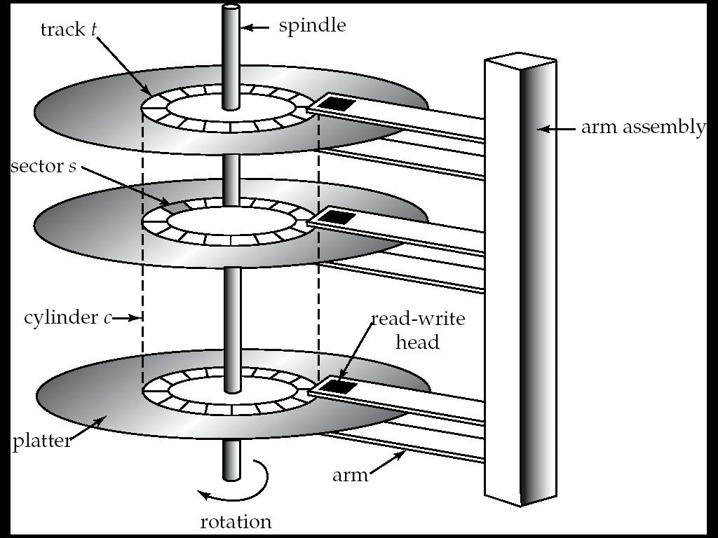
Magnetic Hard Disk Mechanism
30
NOTE: Diagram is schematic, and simplifies the structure of actual disk drives
2/18/2020

Slide 31
Components of a Disk
Spindle
Disk head
Tracks
The platters spin (say, 90rps).
The arm assembly is moved in or out to position a head on a desired track. Tracks under heads make a cylinder (imaginary!).
Sector
Arm movement
Platters
Only one head reads/writes at any one time.
Arm assembly
Block size is a multiple of sector size (which is fixed).
Notes:
31
21

Slide 32
Top view
32
2/18/2020
Notes:
32
22

Slide 33
Top view
33
Track one
2/18/2020
Notes:
33
22

Slide 34
Top view
34
2
3
Sector one
1
4
8
5
7
6
2/18/2020
Notes:
34
22

Slide 35
Filesystems
Files are managed within a “filesystem”
The filesystem defines how and where files are stored within a hard disk (or partition)
Common filesystems include:
FAT16 (MSDOS)
VFAT (Windows 95)
FAT32 (Windows 98)
NTFS (Windows NT)
UFS (UNIX)
ext2/ext3 (Linux)
ISO9660 (CD Roms)
35
2/18/2020

Slide 36
Filesystems
When a disk is formatted, a filesystem is placed on the disk
The filesystem reserves space for the FAT.
The remaining space is available for files
When a file is to be saved into the filesystem, the system looks for the best location to save the file
It is usually best to save the file in contiguous blocks.
If the disk is nearly full, it may not have enough contiguous blocks to save the file. In that case, the filesystem will place the file wherever it can find space.
36
2/18/2020

Slide 37
37
A journey by byte
2/18/2020
Notes:
37

Slide 38
Open a Hard Disk
Slide 38
Draw the scamatic diagram along with its componentsof a HDD
Dr. Azhar, KUET.
2/18/2020

Slide 39
39
Thank you
Dr. Azhar, KUET.
2/18/2020

